Slide 1
Model Integration with SWAT
A publish-subscribe type system
June 24, 2013
André Dozier and Olaf David

Slide 2
Optimization – yearly (or 2-5 year) and 30-50km resolution
IUWM
BMPs
Ensure Economic
Demand = Cons. Use
CGE
Solver
WALL
Solver
SWAT
Solver
Pareto optimal
curve of
management
solutions
Manually
add model
detail
Minimize
Vulnerability and Cost
Supply to WALL
Demand to SWAT
Detailed Assessment Model – daily and 1-5km resolution
SWAT
Read Inputs
MODFLOW
Read Inputs
RT3D
Read Inputs
WALL
Solver
SWAT
HRU calcs
Daily
Loop
DayCent
SWAT
Routing
MODFLOW
Solver
RT3D
Solver
Few
Iterations
SWAT
Output
MODFLOW
Close
RT3D
Close
SWAT
Close

Slide 3
Linkages
Need to add two linking components
SWAT Model
Other Model

Slide 4
Linkages
Need to add two linking components
OMS Simulation
SWAT Model
Other Model

Slide 5
Linkages
Need to add two linking components
OMS Simulation
My Wrapper
My OMS Component
SWAT Model
Other Model

Slide 6
Linkages
Need to add two linking components
OMS Simulation
subscribe
run
component
My Wrapper
publish
My OMS Component
SWAT Model
SWAT
run
direction
inform SWAT
Other Model
finished
event

Slide 7
Linkages
Need to add two linking components
OMS Simulation
My Wrapper
Special OMS Component
Event names
Event inputs
Event outputs
Communication via MPI (use blocking sends)
My OMS Component
Other Model

Slide 8
Linkages
Need to add two linking components
OMS Simulation
My Wrapper
Special OMS Component
Event names
Event inputs
Event outputs
Communication via MPI (use blocking sends)
My OMS Component
Normal (or special if desired) OMS component
Inputs
Outputs
Execution subroutine

Slide 9
Linkages
Need to add two linking components
Simulation specifications
location(s) or NULL
Native or managed?
OMS Simulation
My Wrapper
Special OMS Component
Event names
Event inputs
Event outputs
Communication via MPI (use blocking sends)
My OMS Component
Normal (or special if desired) OMS component
Inputs
Outputs
Execution subroutine

Slide 10
“Events” in SWAT
SWAT
Start
Read Inputs
Year Loop
Month Loop
Daily Loop
End
End
End

Slide 11
“Events” in SWAT
SWAT
Start
Read Inputs
Year Loop
Month Loop
Daily Loop
call TopOfDailyLoop%fire()
End
End
End

Slide 12
“Events” in SWAT
SWAT
Start
Read Inputs
Year Loop
Month Loop
Daily Loop
call TopOfDailyLoop%fire()
End
End
End
Array of function pointers

Slide 13
“Events” in SWAT
SWAT
Start
Read Inputs
Year Loop
Month Loop
Daily Loop
call TopOfDailyLoop%fire()
End
End
End
Array of function pointers
mysub
To “subscribe”
othersub
subroutine mysub()
print *,“my sub”
end subroutine
subroutine othersub()
print *,“other sub”
end subroutine

Slide 14
“Events” in SWAT
SWAT
Start
Read Inputs
Year Loop
Month Loop
Daily Loop
call TopOfDailyLoop%fire()
End
End
End
Array of function pointers
mysub
To “subscribe”
othersub
subroutine mysub()
print *,“my sub”
end subroutine
subroutine othersub()
print *,“other sub”
end subroutine
program subscriber()
use parm
implicit none
integer :: event_i
interface
subroutine mysub()
end subroutine
end interface
interface
subroutine othersub()
end subroutine
end interface
event_i = TopOfDailyLoop%subscribe(mysub)
event_i = TopOfDailyLoop%subscribe(othersub)
call swat_main()
end program

Slide 15
“Events” in SWAT
SWAT
Start
Read Inputs
Year Loop
Month Loop
Daily Loop
call TopOfDailyLoop%fire()
End
End
End
Array of function pointers
mysub
othersub
subroutine mysub()
print *,“my sub”
end subroutine
subroutine othersub()
print *,“other sub”
end subroutine

Slide 16
Special OMS-SWAT Component
SWAT
Start
Read Inputs
Year Loop
Month Loop
Daily Loop
call TopOfDailyLoop%fire()
End
End
call EndOfYear%fire()
End
mpi_input
subroutine mpi_input()
use parm
! Variable initialization
! MPI inputs
call MPI_RECEIVE(buf, …)
! Variable dereferencing
end subroutine
mpi_output
subroutine mpi_output()
use parm
! Variable initialization
! MPI outputs
call MPI_SEND(buf, …)
! MPI wait until finished
call MPI_RECEIVE(buf, …)
! Variable dereferencing
end subroutine

Slide 17
Special OMS-SWAT Component
SWAT
Start
Read Inputs
Year Loop
Month Loop
Daily Loop
call TopOfDailyLoop%fire()
End
End
call EndOfYear%fire()
End
Waits until inputs are
available from another
OMS component
mpi_input
mpi_output
Sends output from
SWAT to OMS with the
option of waiting until
the component has
finished running

Slide 18
Linkages
Need to add two linking components
OMS Simulation
subscribe
run
component
My Wrapper
publish
My OMS Component
SWAT Model
SWAT
run
direction
inform SWAT
Other Model
finished
event

Slide 19
One Possible Orientation
OMS Simulation
SWAT
Start
Read Inputs
Year Loop
Month Loop
Daily Loop
call TopOfDailyLoop%fire()
End
End
call EndOfYear%fire()
End
OMS Component(s)
mpi_input
mpi_output
OMS Component(s)

Slide 20
Another Possible Orientation
OMS Simulation
SWAT
Start
Read Inputs
Year Loop
Month Loop
Daily Loop
call TopOfDailyLoop%fire()
End
End
call EndOfYear%fire()
End
mpi_output
OMS Component(s)
mpi_input
Allows parallel implementation

Slide 21
Yet Another Possible Orientation
OMS Simulation
SWAT
Start
Read Inputs
Year Loop
Month Loop
Daily Loop
call TopOfDailyLoop%fire()
End
End
call EndOfYear%fire()
End
OMS Component(s)
mpi_input
mpi_output
mpi_input
mpi_output

Slide 22
Optimization – yearly (or 2-5 year) and 30-50km resolution
IUWM
BMPs
Ensure Economic
Demand = Cons. Use
CGE
Solver
WALL
Solver
SWAT
Solver
Pareto optimal
curve of
management
solutions
Manually
add model
detail
Minimize
Vulnerability and Cost
Supply to WALL
Demand to SWAT
Detailed Assessment Model – daily and 1-5km resolution
SWAT
Read Inputs
MODFLOW
Read Inputs
RT3D
Read Inputs
WALL
Solver
SWAT
HRU calcs
Daily
Loop
DayCent
SWAT
Routing
MODFLOW
Solver
RT3D
Solver
Few
Iterations
SWAT
Output
MODFLOW
Close
RT3D
Close
SWAT
Close

Slide 23
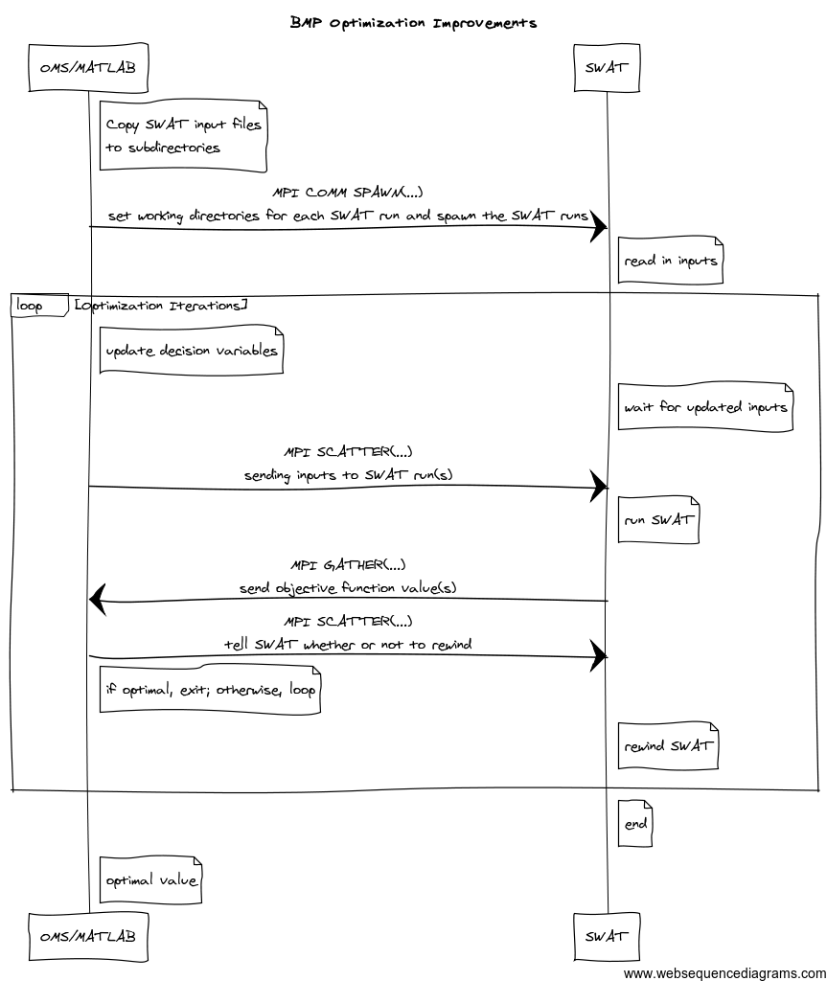
First test case

